Slide 1
Pokémon project
By: Aaron Darrah, Neil Pirch, Tyler De Witt, and Andrew Taylor

Slide 2
Description and constraints
This project will provide a look into the first generation gyms, trainers, and Pokémon.
It will provide a look into each Pokémon and what they evolve to and from if applicable.
The pokémon will be represented with a name, type(s), description.
Trainers will have a name, gym they belong to, and pokémon they use.

Slide 3
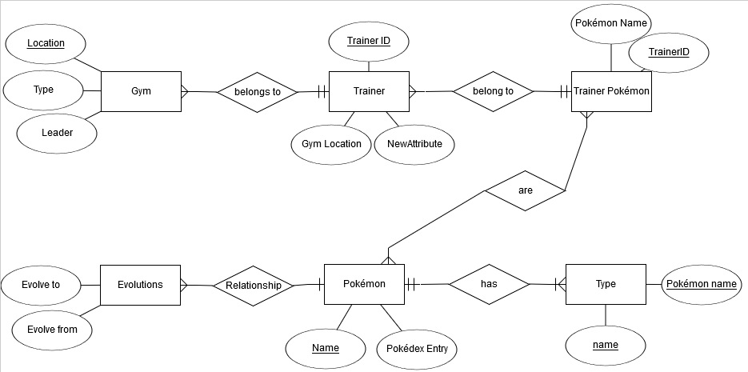
ERD

Slide 4
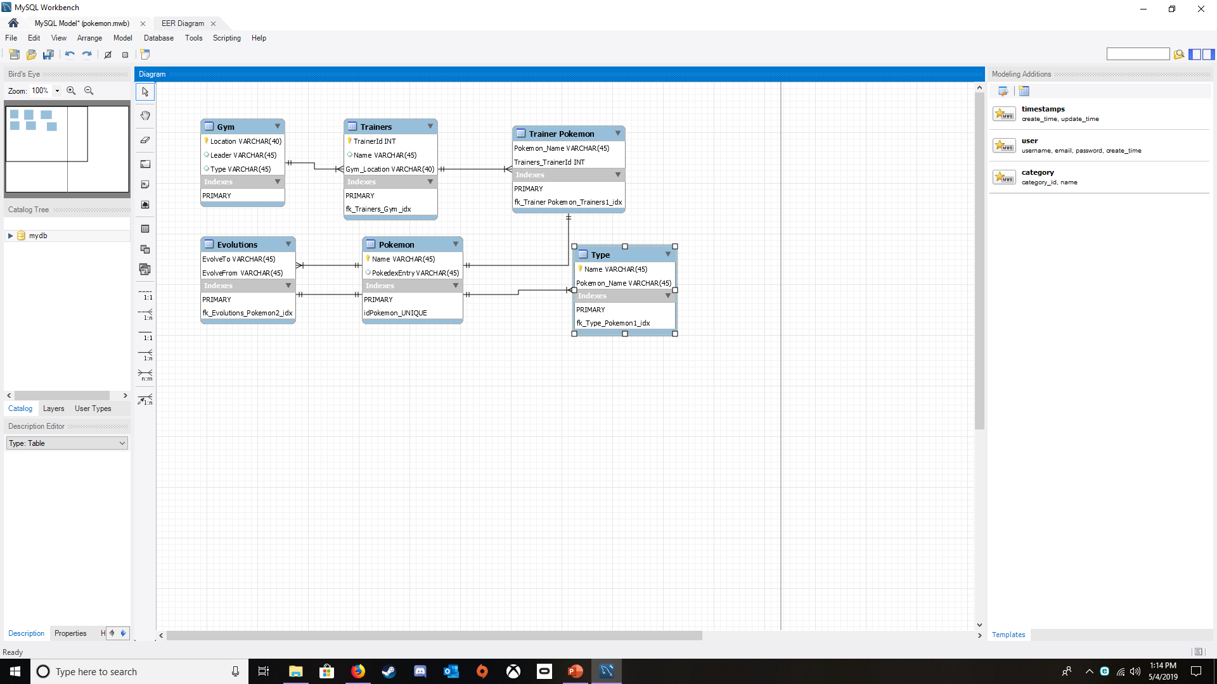

Slide 5
Future Work
Add more Pokémon and moves for each.
Update trainers for future generations.
Add badges when a gym is completed to provide access (views) to the next.
Determine what Pokémon are strong and weak against.

Slide 6
What we’ve learned from this

